Slide 1

Extinguished Lights: A Visual Deep Dive into Infant Mortality
Data: 230
Eshita Gupta

Slide 2

INTRODUCTION AND OVERVIEW
Infant mortality, the heartbreaking loss of a child before age one. It is a global concern that transcends borders and socio-economic divisions.
My project delves into the intricate dynamics of infant mortality, emphasizing the historical context and global impact.
Modern medicine has contributed to a decline, but challenges persist.
The focus extends beyond statistics; My goal is to uncover underlying factors through thought provoking visualizations.

Slide 3
DATA SOURCES
Source | Name and URL | License | Comments
Kaggle | Name: Child and Infant Mortality https://www.kaggle.com/datasets/programmerrdai/child-and-infant-mortality | CC0: Public Domain | Primary Data Set
Kaggle | Name: World Population https://www.kaggle.com/datasets/iamsouravbanerjee/world-population-dataset | CC0: Public Domain | World Countries Data
Kaggle | Name: GDP per Capita for all countries https://www.kaggle.com/datasets/nitishabharathi/gdp-per-capita-all-countries | CC0: Public Domain | World GDP Data

Slide 4
DATA PREPARATION
My dataset, spanning multiple years (1990 – 2019) from Kaggle, comprises of multiple CSV files detailing infant mortality statistics. I have used a subset of this dataset and added additional datasets to get country specific information.
Python Analysis: I used python to check basic structure of the data and identify areas needed transformation or cleaning.
Identified and addressed null values.
Reviewed Data lengths and field names
Identified key factors crucial for visualization and basic data Structure
Prep Builder Integration:
Utilized Prep Builder for seamless data preparation.
Merged multiple CSV files into a unified dataset.
Created Pivot views wherever applicable

Slide 5
DATA PREPARATION
My dataset, spanning multiple years (1990 – 2019) from Kaggle, comprises of multiple CSV files detailing infant mortality statistics. I have used a subset of this dataset and added additional datasets to get country specific information.
Python Analysis: I used python to check basic structure of the data and identify areas needed transformation or cleaning.
Identified and addressed null values.
Reviewed Data lengths and field names
Identified key factors crucial for visualization and basic data Structure
Prep Builder Integration:
Utilized Prep Builder for seamless data preparation.
Merged multiple CSV files into a unified dataset.
Created Pivot views wherever applicable

Slide 6
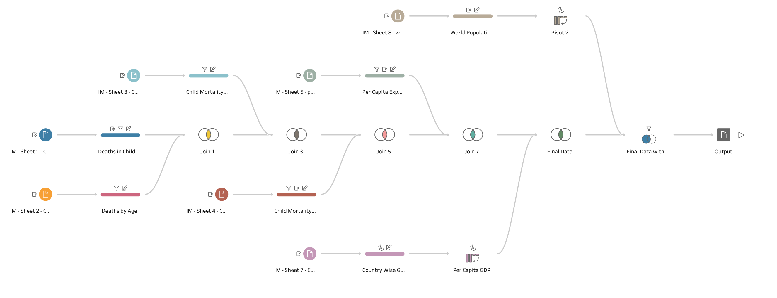
Tableau: Prep Builder Flow

Slide 7
FINAL DATASET
Encompasses essential metrics for in-depth analysis and visualization:
Counts of infant deaths categorized by diseases and factors.
Country-wise metrics.
Population & World Percentage
Current health expenditure
Area
Density
Growth rate.
Age wise split of death counts.
Aggregate columns for critical metrics

Slide 8
Visualization
I invite you to join me in delving into my Tableau workbook, where I've crafted an engaging and interactive story

Slide 9
Conclusion
My tableau story concludes with a profound understanding of infant mortality, unearthing critical insights that resonate with the global healthcare landscape.
The journey through three interconnected dashboards has illuminated not only the challenges but also the opportunities for positive change.

Slide 10
Thank You

